Slide 1
SMS SPAM DETECTOR
PRESENTED BY
S.SRIRAM

Slide 2
SMS SPAM DETECTOR
SMS spam detection is an important task where spam SMS messages are identified and filtered.
As more significant numbers of SMS messages are communicated every day, it is challenging for a user to remember and correlate the newer SMS messages received in context to previously received SMS. Thus, using the knowledge of Java Script. we develop web-based SMS text spam or ham detector.

Slide 3
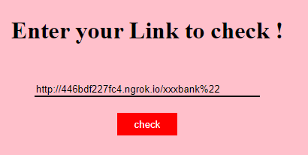
Sample : 1
Paste your Text Message for Checking Spam SMS

Slide 4
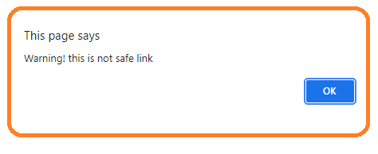
After Analysis It will Promote the warning ! “alert message” as result .

Slide 5
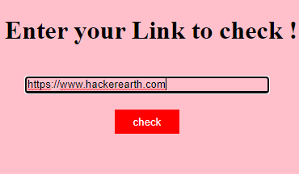
Sample : 2
Paste your Text Message for Checking Spam SMS

Slide 6
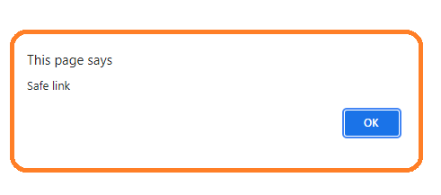
SMS SPAM DETECTOR
After Analysis It will Promote the alert message as result
Sample Result “SMS SPAM DETECTOR”

Slide 7
Thank You

